Slide 1

Genomic Epidemiology
2025-04-08
http://beatricebiologist.tumblr.com/post/95398485056

Slide 2
Outline
Tracking food pathogens (background)
Bioinformatics methods in genomic epidemiology
Genomic epidemiology examples

Slide 3
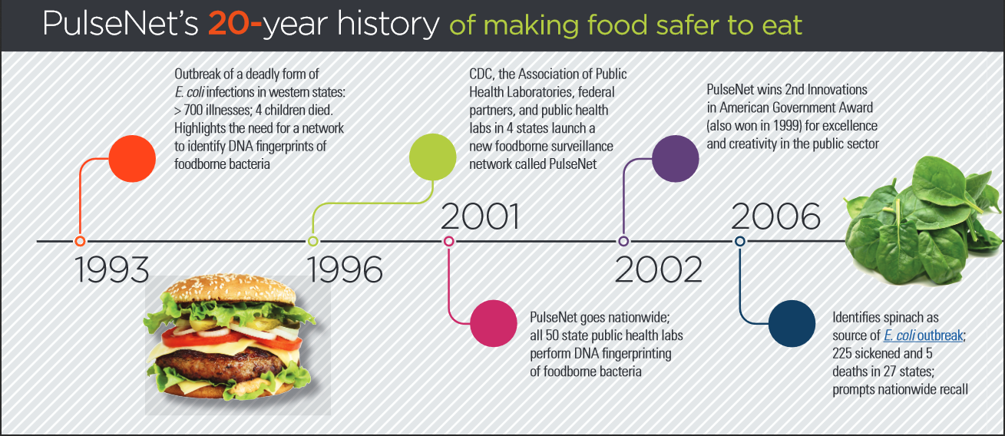

Slide 4
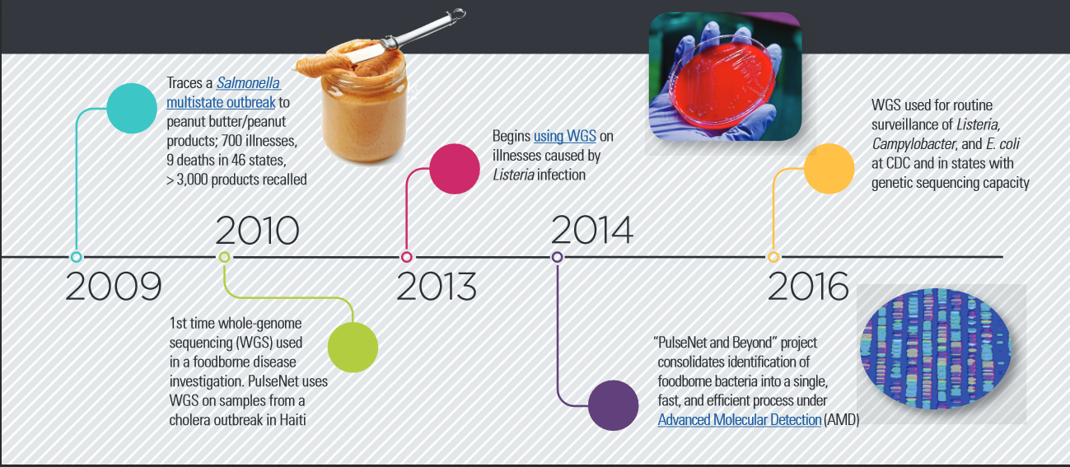

Slide 5
Listeria pilot project
2013-2015
ERIC L. STEVENS, HEATHER A. CARLETON, JENNIFER BEAL, et al; Use of Whole Genome Sequencing by the Federal Interagency Collaboration for Genomics for Food and Feed Safety in the United States. J Food Prot 1 May 2022; 85 (5): 755–772. doi: https://doi.org/10.4315/JFP-21-437
Notes:
CDC, FDA, NCBI, and later FSIS/USDA agreed to whole genome sequence all Listeria monocytogenes in the US

Slide 6

Why Listeria monocytogenes?
Illness is rare but serious, costly, and commonly outbreak associated
Estimated $2.8 billion in annual medical costs and lost productivity ($1.8 million/case)
Current subtyping methods are not ideal
Strong epidemiologic surveillance (Listeria Initiative)
Strong regulatory component
Listeria genome is fairly small, stable, and relatively easy to sequence and analyze. Most changes in the genome are due to point mutations and not phages.
Note: this is information from 2013 and might not be current.
Notes:
Listeria monocytogenes was chosen for this project because it is rare but serious, costly, and commonly outbreak associated, and—critically—controllable. In terms of technology, current subtyping methods are not ideal, whereas the Listeria genome is fairly small and relatively easy to sequence and analyze. Finally, we have both strong epidemiologic surveillance through the Listeria Initiative and a strong regulatory component.

Slide 7
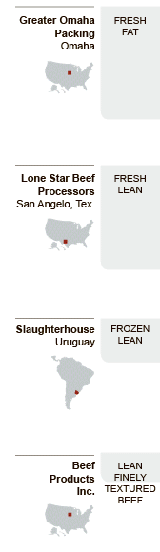



The Problem: Detecting Outbreaks in an Increasingly Globalized Food System
Anatomy of a Burger. New York Times. October 4, 2009
Thanks to Brendan Jackson for letting me borrow this slide

Slide 8


Limitations of Pulsed-Field Gel Electrophoresis (PFGE)
=

Slide 9
Limitation: Genetically Unrelated Isolate Might Appear Same by PFGE
?
=

Slide 10
Limitation: Genetically Related Isolate Might Appear Different By PFGE
?
=

Slide 11
Can genomics clear up this picture?
?
?
?
?

Slide 12
Genome comparison

Slide 13

Major methods we use
Sites
Algorithms
Kmer-based: mile-high view (shredded paper)
MLST-based: naked eye (book pages)
SNP-based: microscope (book letters)
Not covered in this lecture
The question in this analogy: how similar are these two books?

Slide 14
Sites

Slide 15
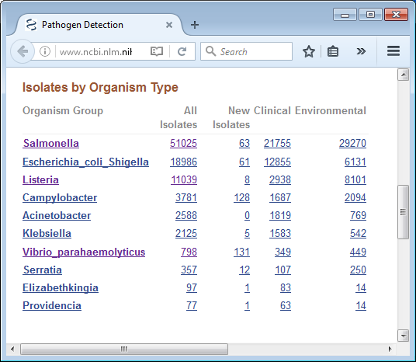
Sites
NCBI Pathogen Detection Pipeline
https://www.ncbi.nlm.nih.gov/pathogens/
EBI Pathogens
https://www.pathogensportal.org/

Slide 16
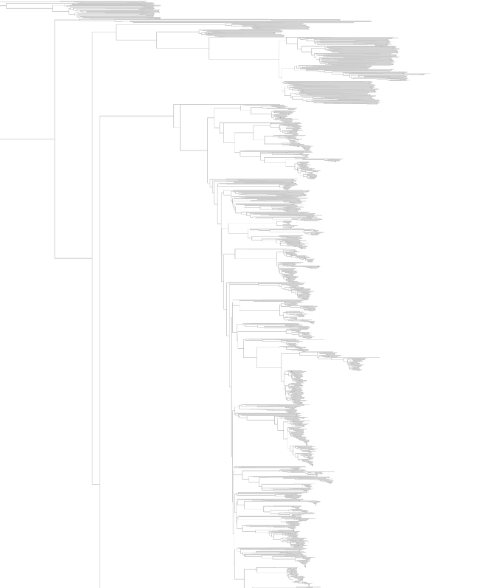
NCBI Pathogens
Someone, somewhere, submits a genome to NCBI
NCBI analyzes
NCBI returns new results
Versioned
Available over FTP
Available over website interface
Example tree accession: PDG000000001.1140
ftp://ftp.ncbi.nlm.nih.gov/pathogen/Results/Listeria/latest_kmer/Trees/PDG000000001.1140.reference_target.tree.pdf
http://www.ncbi.nlm.nih.gov/pathogens/

Slide 17
Additional information
Some URLs
Website interface
https://www.ncbi.nlm.nih.gov/pathogens
FTP results
ftp://ftp.ncbi.nlm.nih.gov/pathogen/Results/
EDLB downloads these results nightly
Each item has accessions
Species-level analyses (PDG)
SNP trees (PDS)
“Targets” genomes (PDT)

Slide 18
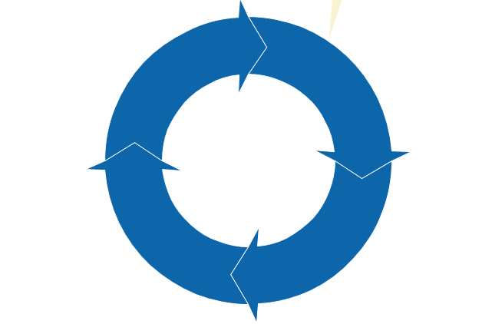
How
0. We send genomes to NCBI
Genome assembly with SKESA
Whole genome MLST
Clustering based on MLST
Create list of genomes within 50 SNPs
Create tree for each cluster of genomes

Slide 19
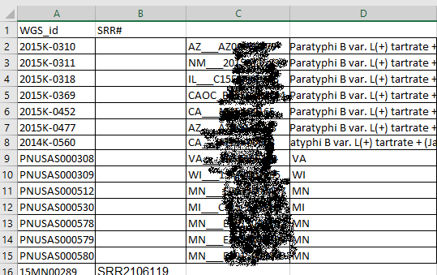
Using NCBI Pathogens for surveillance
Receive line list
Download all genomes for analysis
In this example, search 2015K-0310

Slide 20
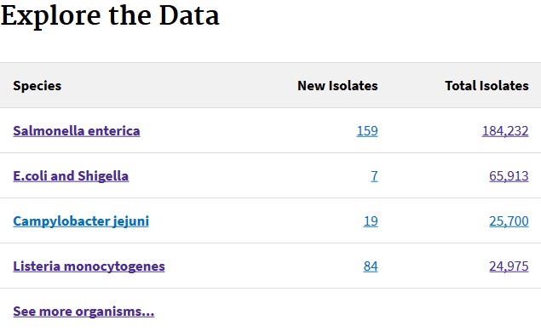
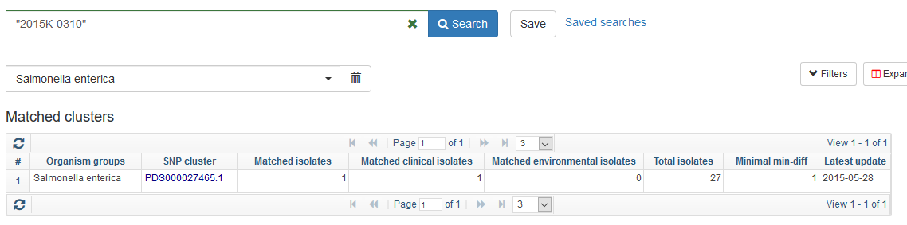
Example: searching 2015K-0310
Go to the main page
Click on Salmonella enterica

Slide 21
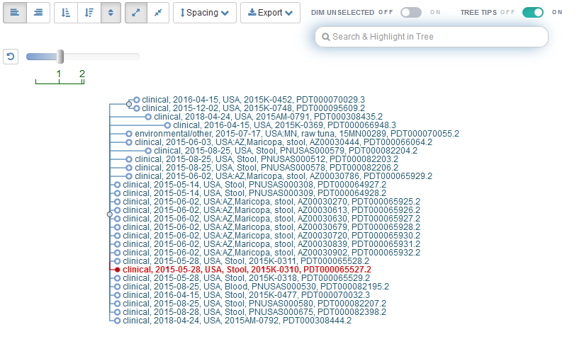
Example: searching 2015K-0310

Slide 22
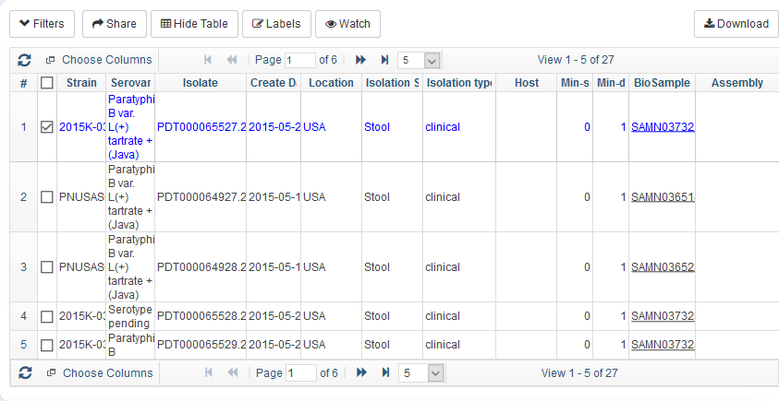
Example: searching 2015K-0310
Download the table of isolates
Add new genomes to the analysis
Continue with downstream analysis

Slide 23
Algorithms
Kmer-based: mile-high view (shredded paper)
MLST-based: naked eye (book pages)

Slide 24

kmers
Kmer: a length of DNA k nucleotides long
Shred all reads in equal sizes k
How many kmers are in common?
Transform into a percentage **
** Known as the jaccard distance
“DEATH OF A SHREDDER” https://digginginthedriftless.com/2011/01/04/death-of-a-shredder
Notes:
In this analogy: each previously shredded piece of paper is further shredded and then compared between piles. Each pile was originally a book.

Slide 25
Kmers, jaccard distance
CAAAAAAAAAAAAT
Here, K=12
CAAAAAAAAAAAAG
CAAAAAAAAAAA AAAAAAAAAAAA
1 1
2 2
3 4
CAAAAAAAAAAA AAAAAAAAAAAA
AAAAAAAAAAAT
AAAAAAAAAAAG
Two out of three kmers different;
Jaccard distance = 2/3 = 0.67

Slide 26

Mashtree
Use Mash distances to create trees
Does not create a phylogeny
Notes:
No phylogeny: no evolution is inferred. No last common ancestor.

Slide 27
Mashtree is command line
# Installation
$ mamba create -y -n mashtree mashtree
# Execution
$ mashtree.pl --numcpus 2 --genomesize 4700000 \
*.fastq.gz \
[*.fasta] [*.gbk] [*.fasta.gz] [*.gbk.gz] \
> mashtree.dnd
https://github.com/lskatz/mashtree
Katz, L. S., Griswold, T., Morrison, S., Caravas, J., Zhang, S., den Bakker, H.C., Deng, X., and Carleton, H. A., (2019). Mashtree: a rapid comparison of whole genome sequence files. Journal of Open Source Software, 4(44), 1762, https://doi.org/10.21105/joss.01762

Slide 28
Kmer-based software
Mashtree
Based on min-hash, implemented in Mash
SKA
Split Kmer Analysis
KSNP4
Split Kmer Analysis
Notes:
https://github.com/lskatz/mashtree (Katz et al 2019, JOSS)
https://github.com/simonrharris/SKA/releases

Slide 29

MLST
MLST: multilocus sequence typing
Locus: a place in a genome. Plural: loci
Identify a set of loci (genes) in the genome
Compare each locus in a genome against the set of loci
Count differences and the number of loci compared
Different kinds
7-gene MLST
wgMLST (whole genome MLST)
cgMLST (core genome MLST)
… and more
Image credit: Wikipedia.org
Software: BioNumerics
Notes:
In this analogy: each page is a locus
Identical pages are counted and divided by the total number of pages compared.

Slide 30
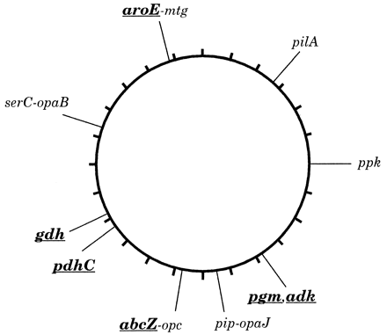

7-gene MLST
Choose about seven loci in the genome
Compare all genomes based on these seven loci
This profile of alleles is called a sequence type (ST)
Maiden et al 1998 PNAS

Slide 31
Animation of MLST
Loci
(Singular: locus)
Assemble the genome
Identify the loci
Call alleles
Compare with other genomes and their alleles
Create a phylogeny
Note: many methods do not require an assembly and these are called assembly-free methods.
Genome 1
Genome 1
Genome 2
Genome 3
Genome 4
100
2014C-
2014C-3
100
2014C-3
2014C-
Phylogeny
2014C-
2014C-3
100
2014C-3
100
2014C-3
2014C-3
0.001

Slide 32
Whole-genome MLST
~one locus per 1,000 nucleotides (nt) in the genome.
Different species have different sizes
e.g., L. monocytogenes has ~3,000,000 nt and ~3,000 loci
Strain A
...
Strain B
...
Strain C
...

Slide 33
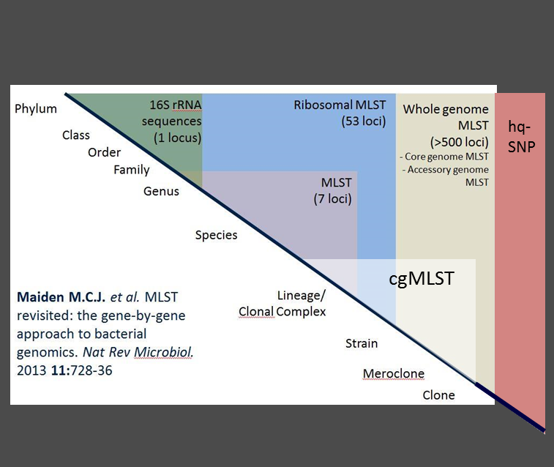
Flavors of multilocus sequence type analysis
Subsets of genes can be used to identify genus/species and lineage (rMLST/ MLST)
Core genome MLST are the genes that are in common in vast majority of genomes belonging to a genus species (for Listeria – 1748 genes belong to core and are present in ~98% of isolates tested)
Maiden et al Nat Rev Microbiol. 2013 11:728-36

Slide 34
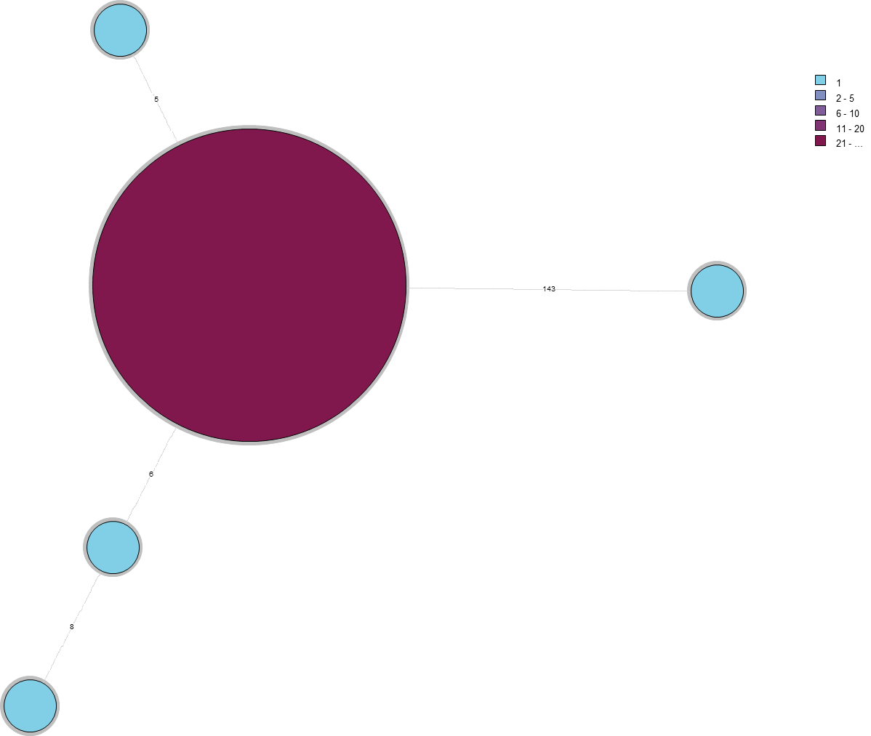
Example wgMLST tree
color | #
 | 1
 | 2-5
 | 6-10
 | 11-20
 | 21 +
Larger circles represent more with the same sequence type (ST)
4800 loci represented
Distances shown on the connecting lines
The style of tree shown is called a minimum spanning tree
wgMLST can also be displayed in a conventional tree
5
143
6
8

Slide 35

MLST software
StringMLST
Compare kmers of raw reads against a database
BioNumerics
Graphical user interface
SRST2, Ariba
Map raw reads onto database
ChewBBACA
wgMLST, based on BLAST
mlst
BLAST genome assembly against database
EToKi
Command line, meant for wgMLST schemes
NCBI wgMLST
Command line, fast, by request at NCBI
Image taken from http://www.applied-maths.com/applications/wgmlst
For more information: Page et al 2017, “Comparison of Multi-locus Sequence Typing software for next generation sequencing data.”

Slide 36
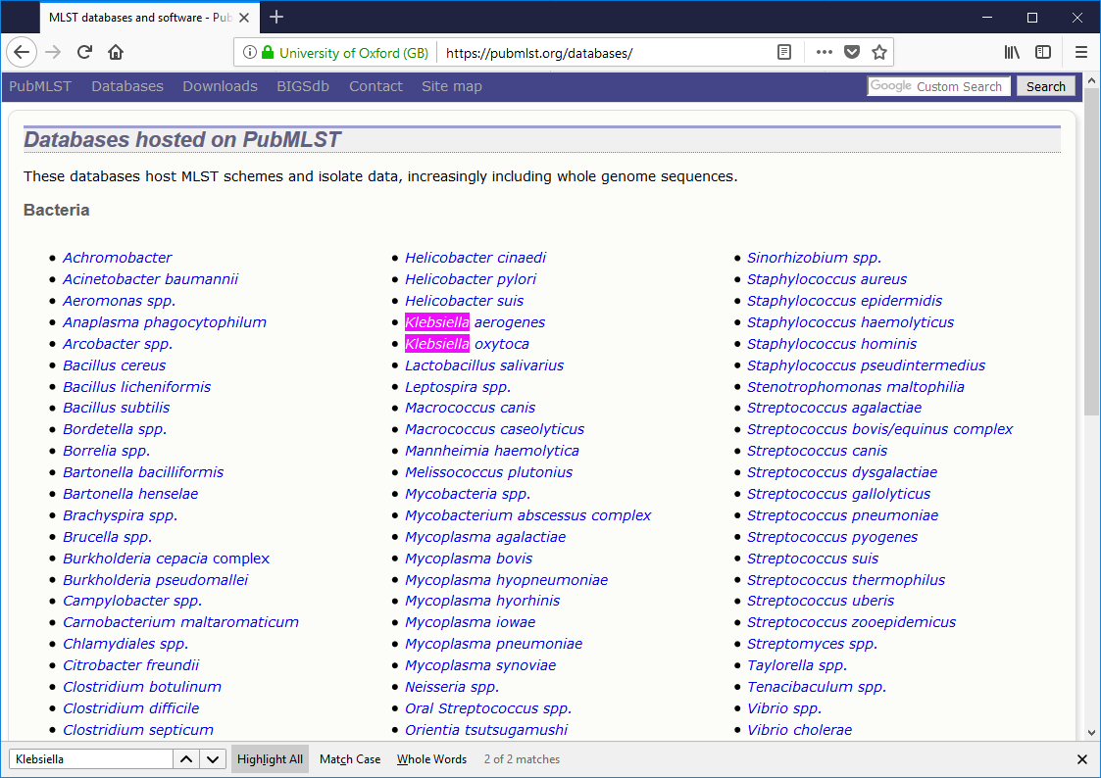
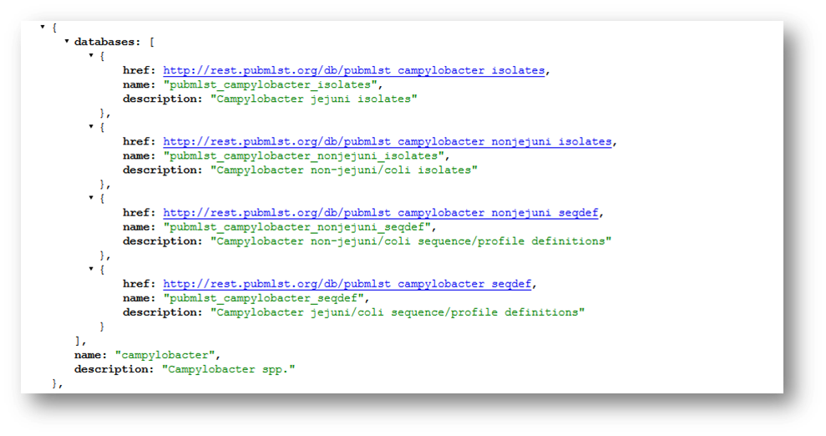
MLST Resources
Main MLST site: https://pubmlst.org/
BigsDB manual: http://bigsdb.readthedocs.io/en/latest/concepts.html
API: https://pubmlst.org/rest/
Also see:
https://enterobase.warwick.ac.uk/
http://bigsdb.web.pasteur.fr/listeria/
Jolley & Maiden 2010, BMC Bioinformatics 11:595
Jolley et al. (2017) Database 2017: bax060

Slide 37
Which algorithm should you use?
 | Kmer-based | 7-gene MLST | wgMLST
Diversity | üü | üü | ü
Outbreak-level resolution | û | û | üü
Further genomic information | û | ü | üü
Minimal upfront effort | ü | ü | ûû
Fast | üü | ü | üü
Easy to use for anyone | û | ü | ü

Slide 38
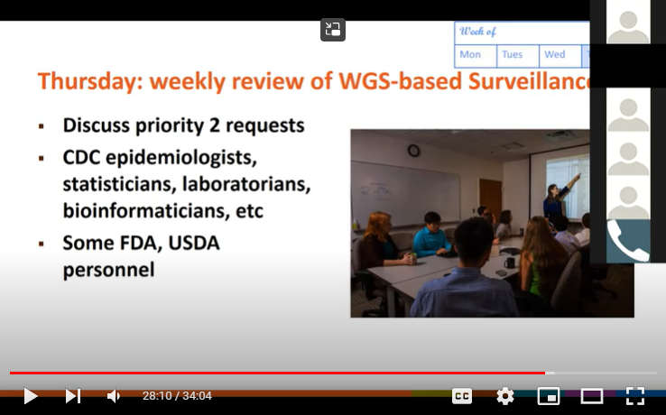
Fun examples
More information can be found in the virtual lab talk given on Jan 7, 2019: https://youtu.be/YPnU63Le53Y?t=1234

Slide 39
Reminder, How to read a phylogeny
Scale bar
Direction of evolution
Outgroup1
taxon
0.01
Outgroup2
taxon
Vertical distance is irrelevant
taxon3
Root
(LCA of all taxa)
100
taxon4
taxa
taxon5
100
taxon6
Percent confidence in hypothetical ancestor
taxon7
Hypothetical last common ancestor (LCA) of taxa 3-7

Slide 40
Phylogenetically related outbreak of unknown etiology, December 2013
1ai
2013L-5
0.02
Between
1ai and 1aii:
14 hqSNPs
[13-16]
2013L-5
1hqSNP [0-2]
2013L-5
1aii
2013L-5
10.5 hqSNPs [0-22]
1a
48 hqSNPs
[0-64]
cold smoked white fish recall 1hqSNP [0-2]
2013L-5
kale
2013L-5
NYC
2013L-5
2013L-5
2013L-5
2013L-5
2013L-5
2013L-5
Farmstead cheese outbreak July 2013

Slide 41
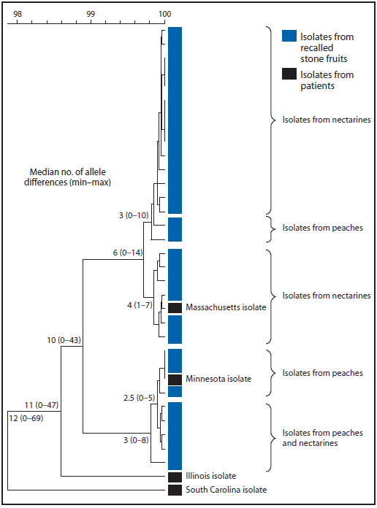
Stone fruit recall

Slide 42
In conclusion
WGS provides high resolution
We have many tools for differing levels of resolution
We can and have used it on outbreak investigations

Slide 43
Can we do this ourselves?
Sure we can!

Slide 44
Focus on some software
NCBI Pathogens
Mashtree
mlst

Slide 45
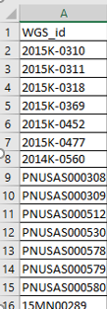
NCBI Pathogens example
Receive line list
Download all genomes for analysis
In this example, search CFSAN023463

Slide 46
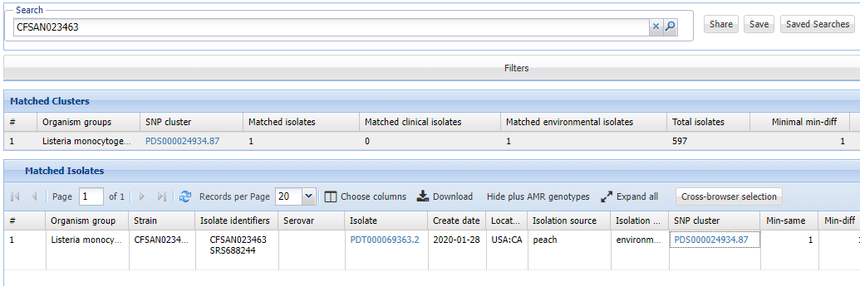
Example: searching CFSAN023463
Go to the main page
Click on Listeria monocytogenes
Search CFSAN023463

Slide 47
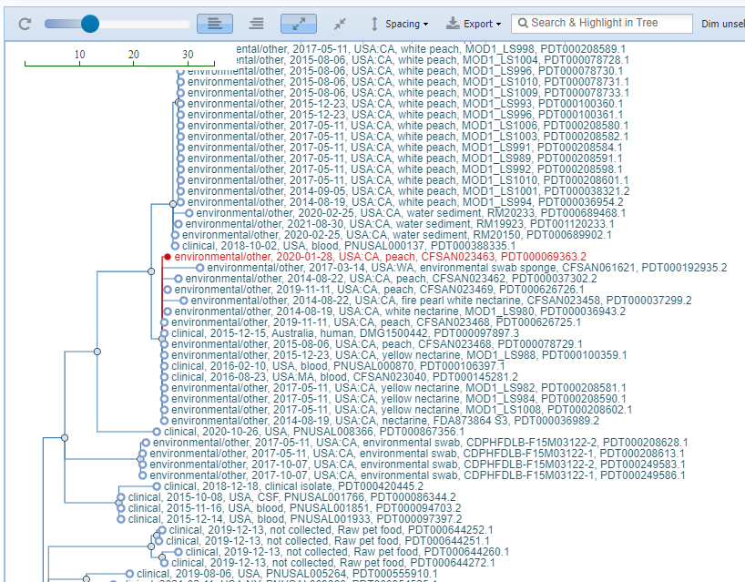
Example: searching CFSAN023463
Notes:
https://ncbi.nlm.nih.gov/pathogens/tree/#Listeria/PDG000000001.3007/PDS000024934.87?accessions=PDT000069363.2
Question: do you see a certain food item shown kind of often in here?

Slide 48
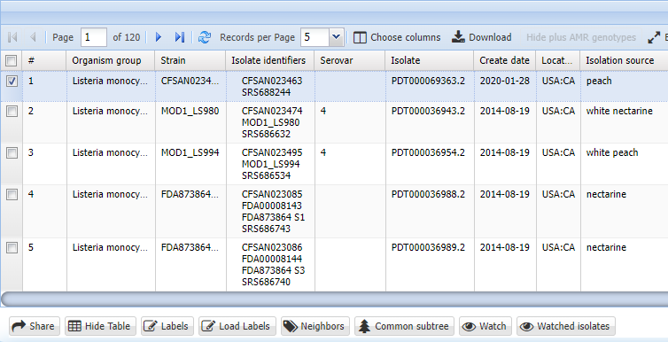
Example: searching CFSAN023463
Download the table of isolates
Add new genomes to the analysis
Continue with more refined analyses
Notes:
https://ncbi.nlm.nih.gov/pathogens/tree/#Listeria/PDG000000001.3007/PDS000024934.87?accessions=PDT000069363.2

Slide 49
MLST of CFSAN023463
$ mamba create -n mlst mlst entrez-direct
$ conda activate mlst
$ mkdir ~/fundamentals/genomic-epi
$ cd ~/fundamentals/genomic-epi
$ esearch -db assembly -query GCA_001047715.2 | elink -target nuccore | efilter -source refseq | efetch -format fasta > CFSAN023463.fasta
$ grep -A 1 ">" CFSAN023463.fasta
>NZ_CP012021.2 Listeria monocytogenes strain CFSAN023463 chromosome, complete genome
TAATTAAATCTAACAATTTCGTTACAGATTTCTTTACACACAAGTTATACACAAGTTAACTGGCTGTGGA
Notes:
esearch to find the assembly identifier from our table
elink to target the nucleotide database “nuccore”
efilter to just get from refseq
efetch to just get fasta format

Slide 50
MLST of CFSAN023463
$ conda activate mlst
$ mlst CFSAN023463.fasta > CFSAN023463.mlst.tsv
[20:50:45] This is mlst 2.23.0 running on linux with Perl 5.032001
[20:50:45] Checking mlst dependencies:
[20:50:45] Found 'blastn' => /home/gzu2/miniconda3/envs/mlst/bin/blastn
[20:50:45] Found 'any2fasta' => /home/gzu2/miniconda3/envs/mlst/bin/any2fasta
[20:50:46] Found blastn: 2.13.0+ (002013)
[20:50:46] Excluding 3 schemes: vcholerae_2 abaumannii ecoli
[20:50:48] Found exact allele match listeria_2.abcZ-1
[20:50:48] Found exact allele match listeria_2.cat-11
[20:50:48] Found exact allele match listeria_2.lhkA-5
[20:50:48] Found exact allele match listeria_2.dat-2
[20:50:48] Found exact allele match listeria_2.dapE-13
[20:50:48] Found exact allele match listeria_2.ldh-5
[20:50:48] Found exact allele match listeria_2.bglA-51
Notes:
after ‘conda activate’ you should see (mlst) in the prompt
Redirecting the output using >
This is the log

Slide 51
MLST of CFSAN023463
$ cat CFSAN023463.mlst.tsv
CFSAN023463.fasta listeria_2 382 abcZ(1) bglA(51) cat(11) dapE(13) dat(2) ldh(5) lhkA(5)
Notes:
This is a tab delimited file but there are no headers in this specific file
first column is the fasta filename
second column is the scheme which it was found. Good idea to check that it matches “Listeria”
382 is the sequence type
Next columns are the genes and their allele numbers

Slide 52
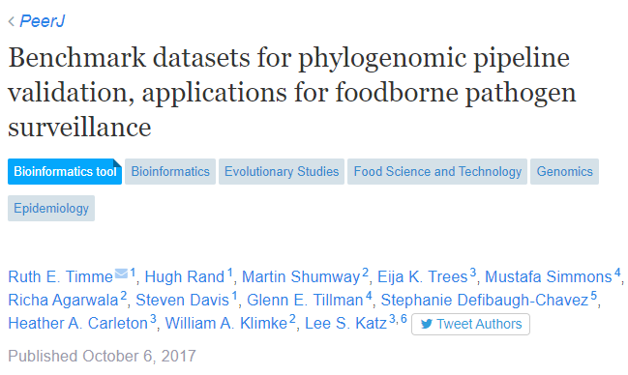
More data
taset | Organism | Number of isolatesª | Epidemiologically linked isolates^{b} | Reference genome^{c} | Type of dataset | Reference/Comment
Stone Fruit Food recall | L. monocytogenes | 31 | 28 | CFSAN023463 | Empirical | PMID: 27694232
Spicy Tuna outbreak | S. enterica | 23 | 18 | CFSAN000189 | Empirical | PMID: 25995194
Raw Milk Outbreak | C. jejuni | 22 | 14 | D7331 | Empirical | http://www.outbreakdatabase.com/details/hendricks-farm-and-dairy-raw-milk-2008/
Sprouts Outbreak | E. coli | 10 | 3 | 2011C-3609 | Empirical | http://www.cdc.gov/ecoli/2014/o121-05-14/index.html
Notes:
https://peerj.com/articles/3893/
https://doi.org/10.7717/peerj.3893/supp-1

Slide 53

The Listeria monocytogenes dataset
Notes:
The L. monocytogenes dataset (Table S1) comprises genomes spanning the genetic diversity of the 2014 stone fruit recall (Jackson et al., 2016; Chen et al., 2016). In this event, a company voluntarily recalled certain lots of stone fruits (peaches and the like) based on the company’s internal tests, which were positive for the presence of L. monocytogenes. This dataset describes a polyclonal phylogeny having three major subclades, two of which include clinical cases. The genome for one isolate was closed, yielding a complete reference genome. This dataset also includes three outgroups that were not associated with the outbreak.

Slide 54
Homework
Will get a few isolates from this dataset
Find them in NCBI Pathogens
Run Mashtree on them
Find their sequence type using MLST

